Slide 1
Modern C++
Introduction to C++

Slide 2
Outline
What is and why C++?
C++ applications and features.
First Program.
Variables and data types.
Compilation Process.

Slide 3
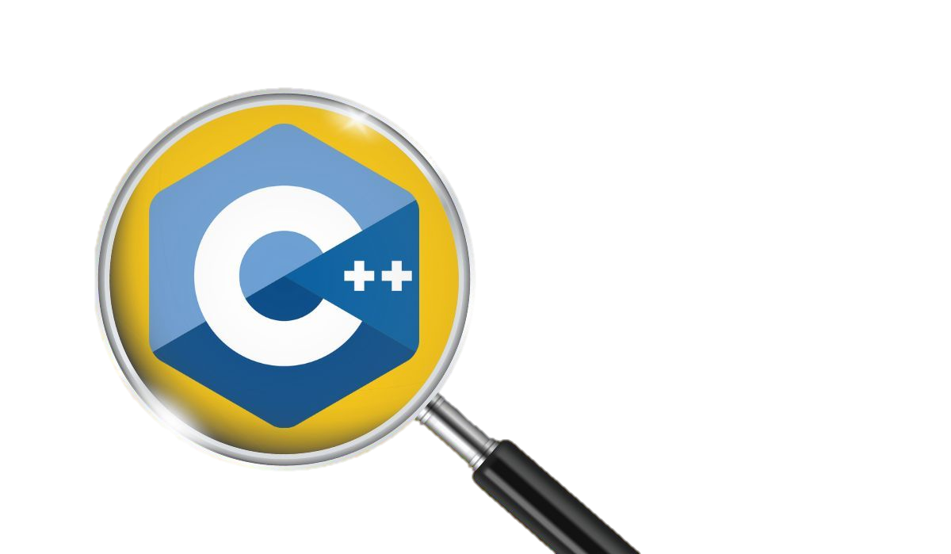
What is C++?
C++ was developed by Bjarne Stroustrup while working on his Ph.D. thesis at Bell Labs in 1979. He wanted to create a dynamic language that would allow programmers to build complex systems with high-level abstractions while providing low-level hardware access. providing low-level hardware access.
C++ combines low-level features from C and high-level features from object-oriented programming (OOP) languages, making it a versatile and powerful language.

Slide 4
History of C++
Subsequent Standards
Standardization
C++98 Standard
Origin and Development
C++11 Standard
Features and Use Cases
Over the years, C++ has become one of the most widely used programming languages and has a variety of applications in areas like gaming, robotics, finance, and scientific computing. The developers have also introduced several new versions of the language with considerable changes in the spirit of staying up-to-date and competing with other modern programming languages. So, let's have a look at the timeline and version history of C++.
The first edition of "The C++ Programming Language," Stroustrup's seminal book, was published in 1985.
The American National Standards Institute (ANSI) began working on standardizing the C++ language in the late 1980s. The ANSI/ISO standard for C++ was finalized in 1998.
The next significant update to the language came with the C++11 standard, officially titled ISO/IEC 14882:2011. This release, in 2011, brought numerous new features and improvements, including auto keyword, range-based for loops, and smart pointers.
Following C++11, there have been regular updates to the language. Some notable standards include C++14 (2014), C++17 (2017), and C++20 (2020). Each of these updates introduced new features, improvements, and enhancements to the language.
The C++98 standard, also known as C++98 or ISO/IEC 14882:1998, formalized the language and introduced many features that are now considered fundamental to C++.
In 1979, Bjarne Stroustrup, a Danish computer scientist at Bell Labs, created C++, a language blending C's low-level features with Simula's high-level ones. The initial version, called "C with Classes," was implemented in 1983.
C++ is known for its efficiency, performance, and versatility. It has been widely used in systems programming, game development, embedded systems, high-performance computing, and various other domains.

Slide 5
Origin and Development
Standardization
C++98 Standard
C++11 Standard
Subsequent Standards
Features and Use Cases
In 1979, Bjarne Stroustrup, a Danish computer scientist at Bell Labs, created C++, a language blending C's low-level features with Simula's high-level ones. The initial version, called "C with Classes," was implemented in 1983.
The first edition of "The C++ Programming Language," Stroustrup's seminal book, was published in 1985.
The American National Standards Institute (ANSI) began working on standardizing the C++ language in the late 1980s. The ANSI/ISO standard for C++ was finalized in 1998.
The C++98 standard, also known as C++98 or ISO/IEC 14882:1998, formalized the language and introduced many features that are now considered fundamental to C++.
The next significant update to the language came with the C++11 standard, officially titled ISO/IEC 14882:2011. This release, in 2011, brought numerous new features and improvements, including auto keyword, range-based for loops, and smart pointers.
Following C++11, there have been regular updates to the language. Some notable standards include C++14 (2014), C++17 (2017), and C++20 (2020). Each of these updates introduced new features, improvements, and enhancements to the language.
C++ is known for its efficiency, performance, and versatility. It has been widely used in systems programming, game development, embedded systems, high-performance computing, and various other domains.

Slide 6

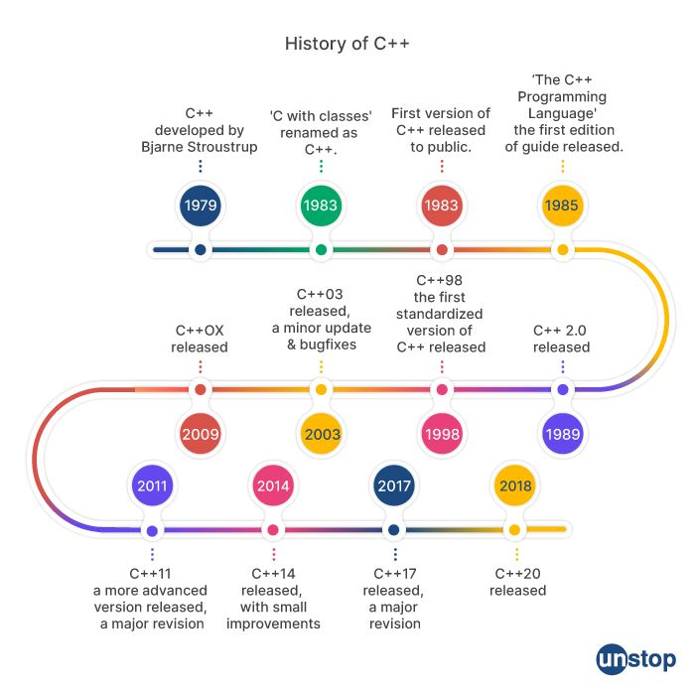

Slide 7
C++ Applications:
Embedded Systems
Computer Vision
Robotics
Network
Game development
Finance
Operating system
Web applications
Security
Others…

Slide 8
Features of c++:
C++ can create a program as procedural/functional like C
Direct access to memory through pointers and smart pointers.
Bit manipulation using the bitwise operator.
C++ can be Object-oriented like C#, Java, and Python.
Efficiency
C++ is very recommended when the performance is needed.
C++ is very good in memory management.

Slide 9
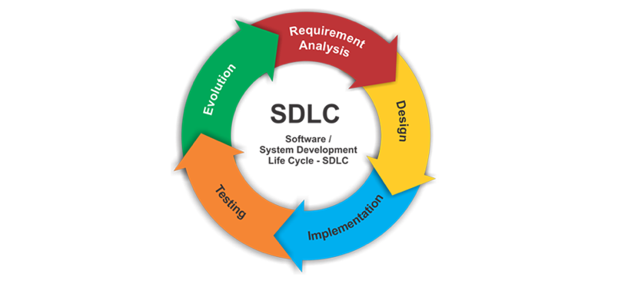
Program:
Step-by-step process to solve a computational problem.
Analyze the problem.
Implementation.
Maintenance.
Software Development Life Cycle.

Slide 10
First program:
Steps
Create a folder for C++
Create a file ending with .cpp
Open with any text editor.
Write the program.
Save the program.
#include <iostream>
int main()
{
std::cout << “Hello World”;
}
Example
Now open CMD or any terminal.
Build the program with the following commands.
$ g++ -o [ exe file name ] [ file name.cpp ]
Run the program
$ ./ [ exe file name ]
$ g++ -o main main.cpp
$ ./main

Slide 11
Variables and data types.
Variables in C++ are fundamental components used to store and manipulate data in a program.
Here are the key points you might want to include in your slides:
Definition.
Declaration.
Initialization.
Assignment.
Data Types:
C++ supports various data types such as int, float, double, char, etc.
Choose a data type based on the type of data the variable will store.

Slide 12
Naming conventions:
Start with a letter or underscore.
Subsequent characters can be letters, digits, or underscores.
Case-sensitive.
Best Practices:
Choose meaningful variable names.
Initialize variables when declaring them.
Keep variable scopes as narrow as possible.

Slide 13
Compilation process:
Source-file
Hello world
Pre-processing
Compilation
Assembly
Linker
Executable

Slide 14
Pre-processing:
Objective: Prepare the source code for compilation.
Actions:
Inclusion of header files (#include directives).
Expansion of macros (#define directives).
Removal of comments.
Conditional compilation (#ifdef, #ifndef, #endif).
Assembly:
Objective: Convert the assembly code into machine code (binary).
Linking:
Objective: Combine multiple object files and libraries into a single executable.
Compilation:
Objective: Translate the pre-processed source code into assembly code.
Loader (Run-time):
Objective: Load the executable into memory for execution.

Slide 15
C++ Operators:
Type
Operator | Type
++,-- | Unary Operator
+, -, *, /, % | Arithmetic Operators
=, +=, -=, *=, /= | Assignment Operators
<, <=, >=, ==, != | Relational Operators
&&, ||, ! | Logical Operators
&, | <<, >>, ~, ^ | Bitwise Operators
?: | Ternary
Operators are symbols that perform operations on variables and values. For example, + is an operator used for addition, while - is used for subtraction.
Operators in C++ can be classified into 6 types:
Arithmetic Operators
Assignment Operators
Relational Operators
Logical Operators
Bitwise Operators
Tenary
Unary Operators
Binary Operators
Ternary Operators

Slide 16
C++ Operators:
Type
Operator | Type
++,-- | Unary Operator
+, -, *, /, % | Arithmetic Operators
=, +=, -=, *=, /= | Assignment Operators
<, <=, >=, ==, != | Relational Operators
&&, ||, ! | Logical Operators
&, | <<, >>, ~, ^ | Bitwise Operators
?: | Ternary
Unary Operators
Binary Operators
Ternary Operators

Slide 17
Scope of variable:
Scope = life time
The area under which a variable is applicable or alive called scope.
Strict definition: a block or a region where a variable is declared, defined, and used, and where a block or region ends, the variable is automatically destroyed.
The scope starts when the “ { “ symbol is declared.
Variable initialized.
The scope ends when the “ } “ symbol is declared.
{
int var = 10;
}
Local Variable

Slide 18
Global Variable | Local Variable
Global variables are declared outside all the function blocks. | Local Variables are declared within a function block.
The scope remains throughout the program. | The scope is limited and remains within the function only in which they are declared.
Any change in global variable affects the whole program, wherever it is being used. | Any change in the local variable does not affect other functions of the program.
A global variable exists in the program for the entire time the program is executed. | A local variable is created when the function is executed, and once the execution is finished, the variable is destroyed.
It can be accessed throughout the program by all the functions present in the program. | It can only be accessed by the function statements in which it is declared and not by the other functions.
If the global variable is not initialized, it takes zero by default. | If the local variable is not initialized, it takes the garbage value by default.
Global variables are stored in the data segment of memory. | Local variables are stored in a stack in memory.
We cannot declare many variables with the same name. | We can declare various variables with the same name but in other functions.

